Slide 1
Quasi-Monte Carlo Methods for Option Pricing

Slide 2
Agenda
1.Introduction
2.Low Discrepancy Sequences
3.Conclusions

Slide 3
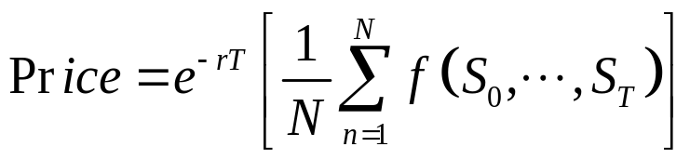

1.Introduction
Monte Carlo (MC)
Monte Carlo is flexible but still have the deficiency of convergence speed .

Slide 4
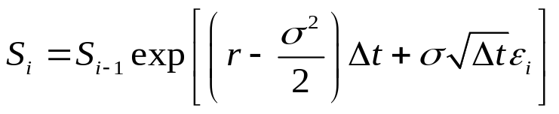
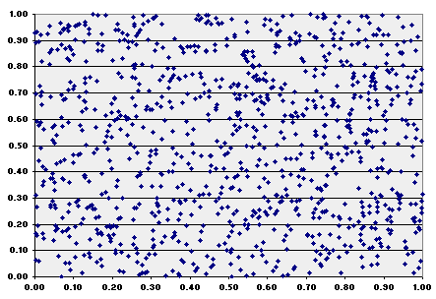
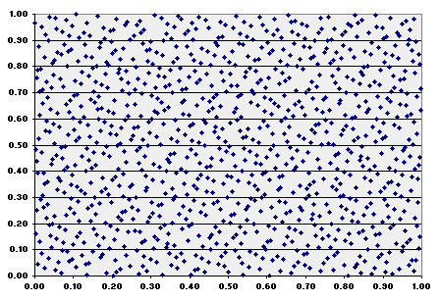
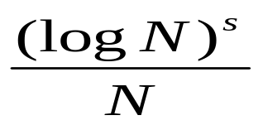
Quasi-Monte Carlo Methods
GBM
Pseudo Random Numbers
Low Discrepancy Sequences
Rand()
Halton Sequences
Faure Sequences
Sobol Sequences
convergence speed

Slide 5
Agenda
1.Introduction
2.Low Discrepancy Sequences
  Halton Sequencs
  Faure Sequences
  Sobol Sequences
  Normal Inversion Methods
3.Numerical Results
4.Conclusions

Slide 6

Discrepancy
Discrepancy of a sequence(X0,X1,X2…)

Slide 7
Low-discrepancy sequence
Sequence with the property that for all N, the subsequence x1, ..., xN is almost uniformly distributed and x1, ..., xN+1 is almost uniformly distributed as well.
quasi-random sequence
The "quasi" modifier is used to denote more clearly that the numbers are not random, and rather deterministic

Slide 8



Low Discrepancy Sequences
Halton sequence

Slide 9
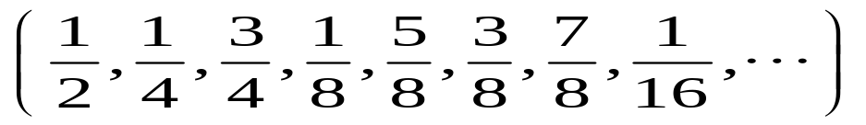
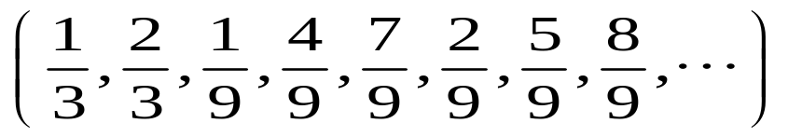
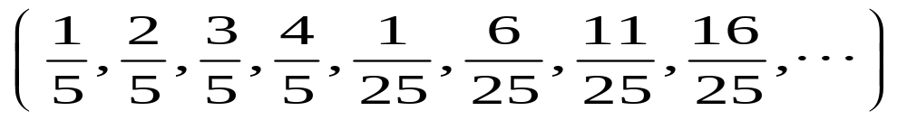
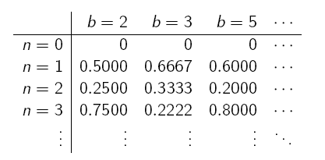
Dim1 base=2
Dim2 base=3
Dim3 base=5
Drawbacks:
  Monotonically increasing
  High correlation

Slide 10
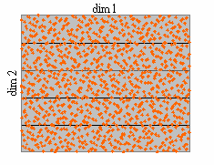
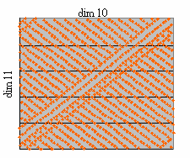
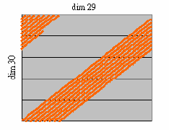
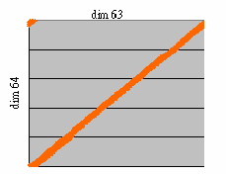
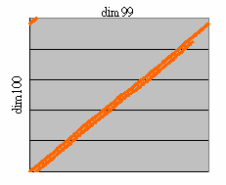
Halton sequence
Two-Dimensional Projections

Slide 11
Code for Halton Sequence
Halton:
for example:
double ma[20][1000]; //存放亂數的容器
int dim_times=1000; //每個dimension需要1000個亂數
int dim_num=20; //需要20 dimensions
int step=10; //每個dimension從第10個值開始
double r[DIM_NUM]; //計算亂數的容器
halton_ndim_set ( dim_num );//設定 dimension numbers
halton_step_set ( step );//設定第幾個值開始
for (int i = 0; i <dim_times; i++ )
{ halton( r ); //產生1~20 dimension 的第10個值
for(int k=0;k<DIM_NUM;k++) //將產生的亂數向量存入 自己的容器
ma[k][i]=r[k];
}

Slide 12
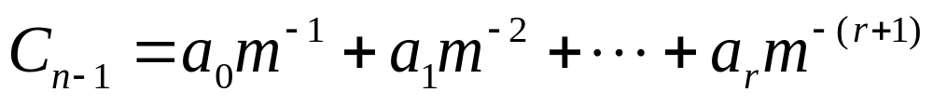
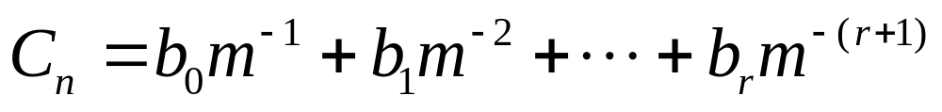
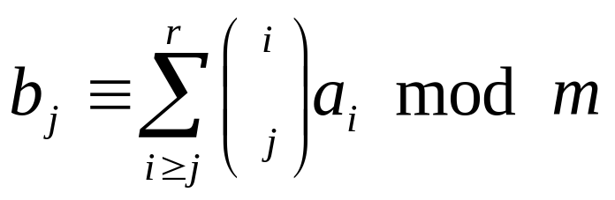
Low Discrepancy Sequences
-Faure sequence-
where
Use the smallest prime number larger than the dimension D as base of all sequences

Slide 13
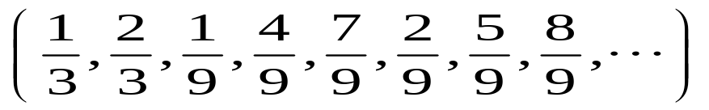
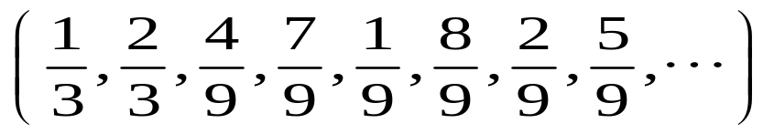
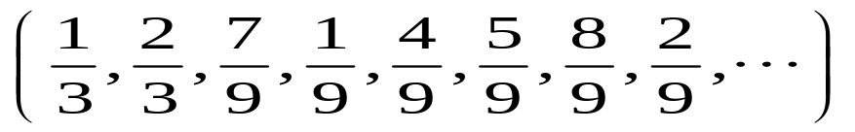
Dim1 base=3
Dim2 base=3
Dim3 base=3
Drawbacks
(same as halton)
  Cycle length
  High correlation

Slide 14
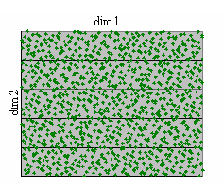
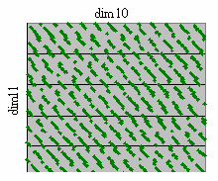
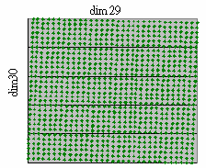
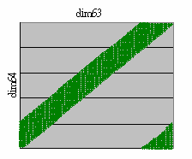
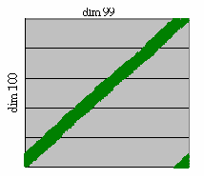
Faure sequence
Two-Dimensional Projections

Slide 15
Code for Faure Sequence
Faure
for example:
double ma[20][1000]; //存放亂數的容器
int dim_times=1000; //每個dimension需要1000個亂數
int dim_num=20; //需要20 dimensions
int seed=-1; //每個dimension從第seed值開始
//if Seed<0.....start (bs)^(4)-1 -->bs means base
//if Seed>0.....start seed
double r[DIM_NUM]; //計算亂數的容器
for (int i = 0; i <dim_times; i++ )
{ faure ( dim_num, &seed, r ); //產生1~20 dimension 的第seed個值
for(int k=0;k<DIM_NUM;k++) //將產生的亂數向量存入 自己的容器
ma[k][i]=r[k];
}

Slide 16
Sobol sequence
Steps:
1. Assign the length of sequence N and
D polynomials
2. Choose r direction numbers
3. Calculate other direction number by
recurrence

Slide 17

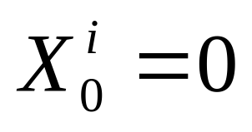

Sobol sequence-cont
4. Calculate the sequence for each
dimension recursively, where m = lg N and
c is the position of the rightmost zero bit in
the binary representation of k

Slide 18
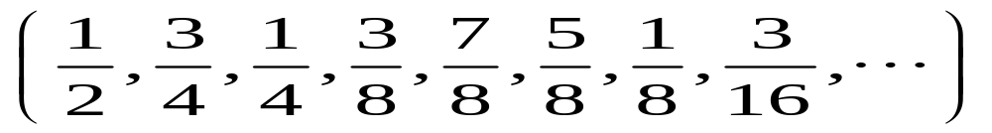
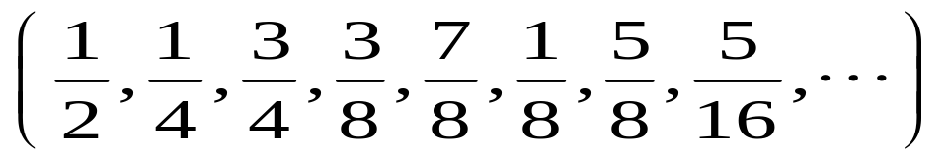
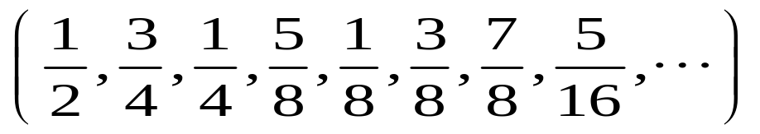
Dim1 base=2
Dim2 base=2
Dim3 base=2

Slide 19
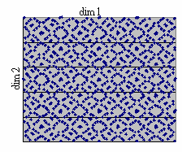
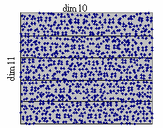
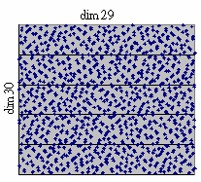
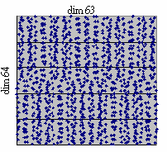
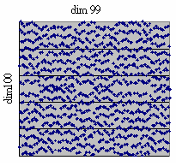
Sobol sequence
Two-Dimensional Projections

Slide 20
Code for Sobol Sequence
Sobol
for example:
double ma[20][1000]; //存放亂數的容器
int dim_times=1000; //每個dimension需要1000個亂數
int dim_num=20; //需要20 dimensions
int seed=16; //每個dimension從第seed值開始
for (int i = 0; i <dim_times; i++ )
{ i4_sobol (dim_num, &seed, r ); //產生1~20 dimension 的第seed個值
for(int k=0;k<DIM_NUM;k++) //將產生的亂數向量存入 自己的容器
ma[k][i]=r[k];
}

Slide 21
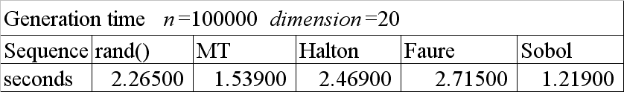
Generation time

Slide 22
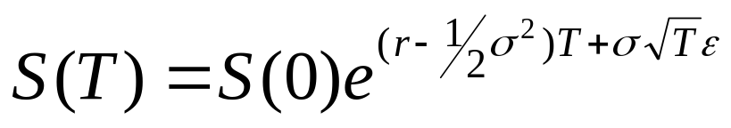
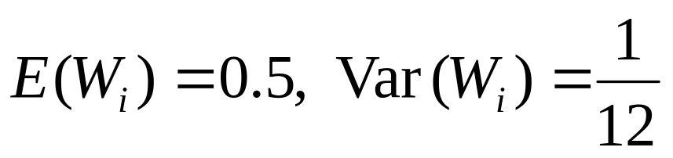
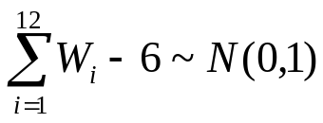
常態分配隨機變數建立
做財務模擬程式經常需要常態隨機變數
常態分配變數可用下列方式逼近
  使用RAND()產生 0~1 的 uniformly distributed的隨機變數
  假定產生的變數為Wi
  根據中央極限定理:
程式範例:
double Normal=0;
for(int j=0;j<12;j++)
{
Normal=Normal+double(rand())/RAND_MAX;
}
Normal=Normal-6;

Slide 23




Polar Method
Given (Z1,Z2) uniformly distributed on the unit disk
Then where
sample (V1,V2) uniformly from [-1,1]x[-1,1]
until , set (Z1,Z2) = (V1,V2)

Slide 24
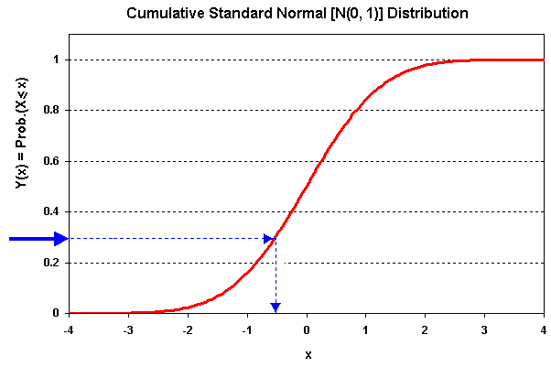
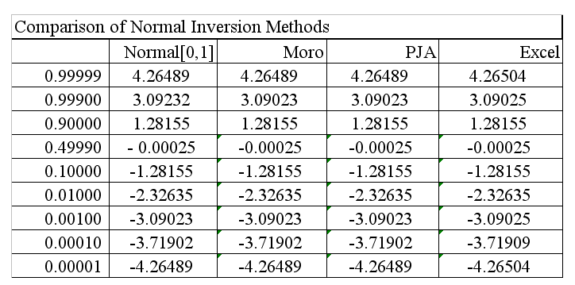
Normal Inversion

Slide 25
Agenda
1.Introduction
2.Low Discrepancy Sequences
3.Numerical Results
  Evaluation with vanilla option
4.Conclusions

Slide 26
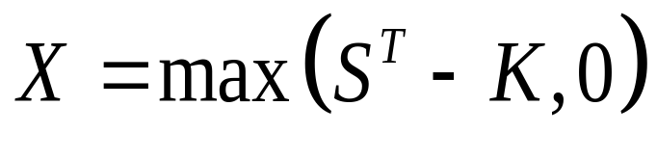
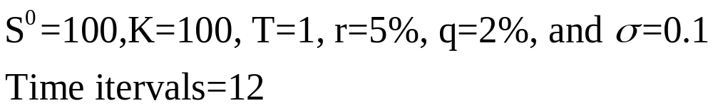
Evaluation with vanilla options
Payoff:
Parameter:

Slide 27
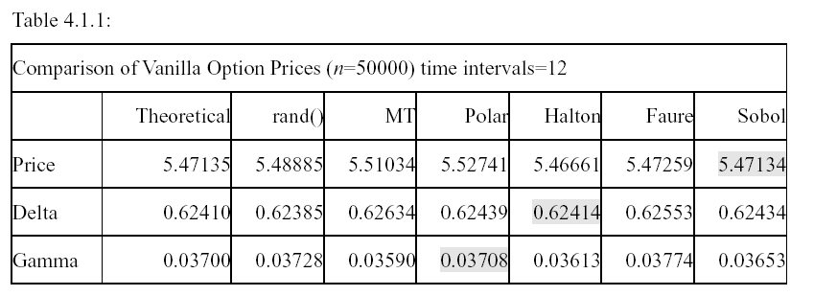
Evaluation with vanilla options

Slide 28
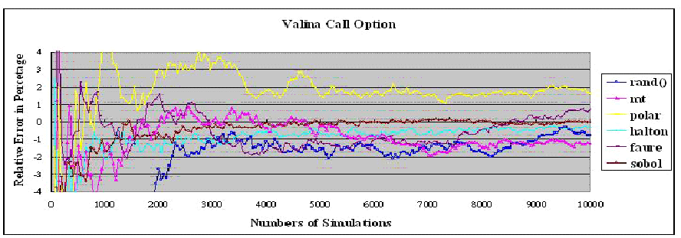

Slide 29
Agenda
1.Introduction
2.Low Discrepancy Sequences
3.Numerical Results
4.Conclusions

Slide 30
Conclusion
The Sobol sequence can be generated significantly faster than all the other sequences.
In low dimensions, the performance of QMC is much better than standard MC .

Slide 31
Conclusion
For high-dimensional integrals, Sobol sequences exhibit better convergence properties than either the Faure or the Halton sequences.
If the dimension is under 100, QMC using Sobol exhibits better convergence than standard MC.

